Slide 1
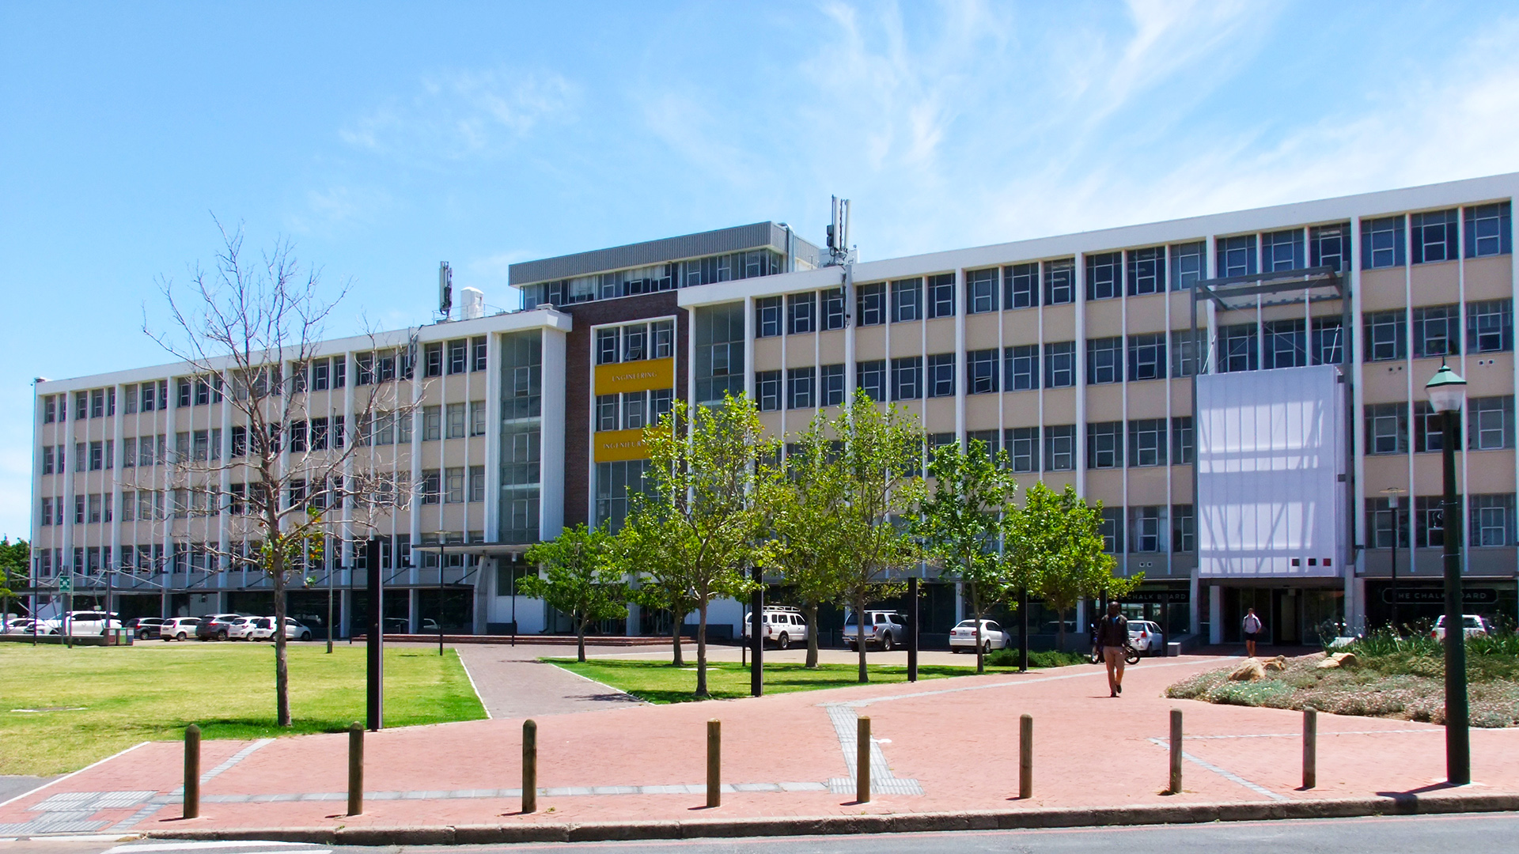
Weekly Meeting 5 Mei 2026 By Pieter Breytenbach
Photo by Stefan Els
Notes:
Picture placeholder slide layout
To change the picture:
Select the picture by clicking on it near the bottom of the slide (under the title placeholder), then click on the Picture Format tab.
Click on the Change Picture icon and choose the From a File/This Device… option.
Browse and select a picture and click on the Insert button.
Use the Crop command to adjust the image.
Click on the Crop command again to apply the changes.
Remember to add image attributions to photographs or artworks.

Slide 2
Last Week Meeting
Preliminary Detail Design
Design Problem with the tip and the heat coupler

Slide 3
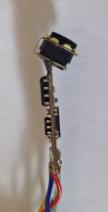
This weeks progress
Fixed the endoscope camera at 30° viewing angle.
Fine modelling of the endoscope camera

Slide 4
This week’s planned progress
Finish Drawing Pack of Laparoscope
Start with the heat analysis

Slide 5
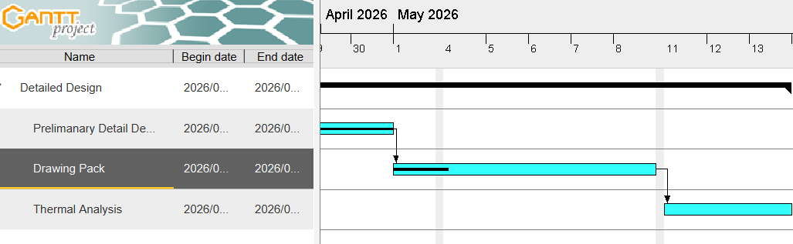
Gantt Chart

Slide 6
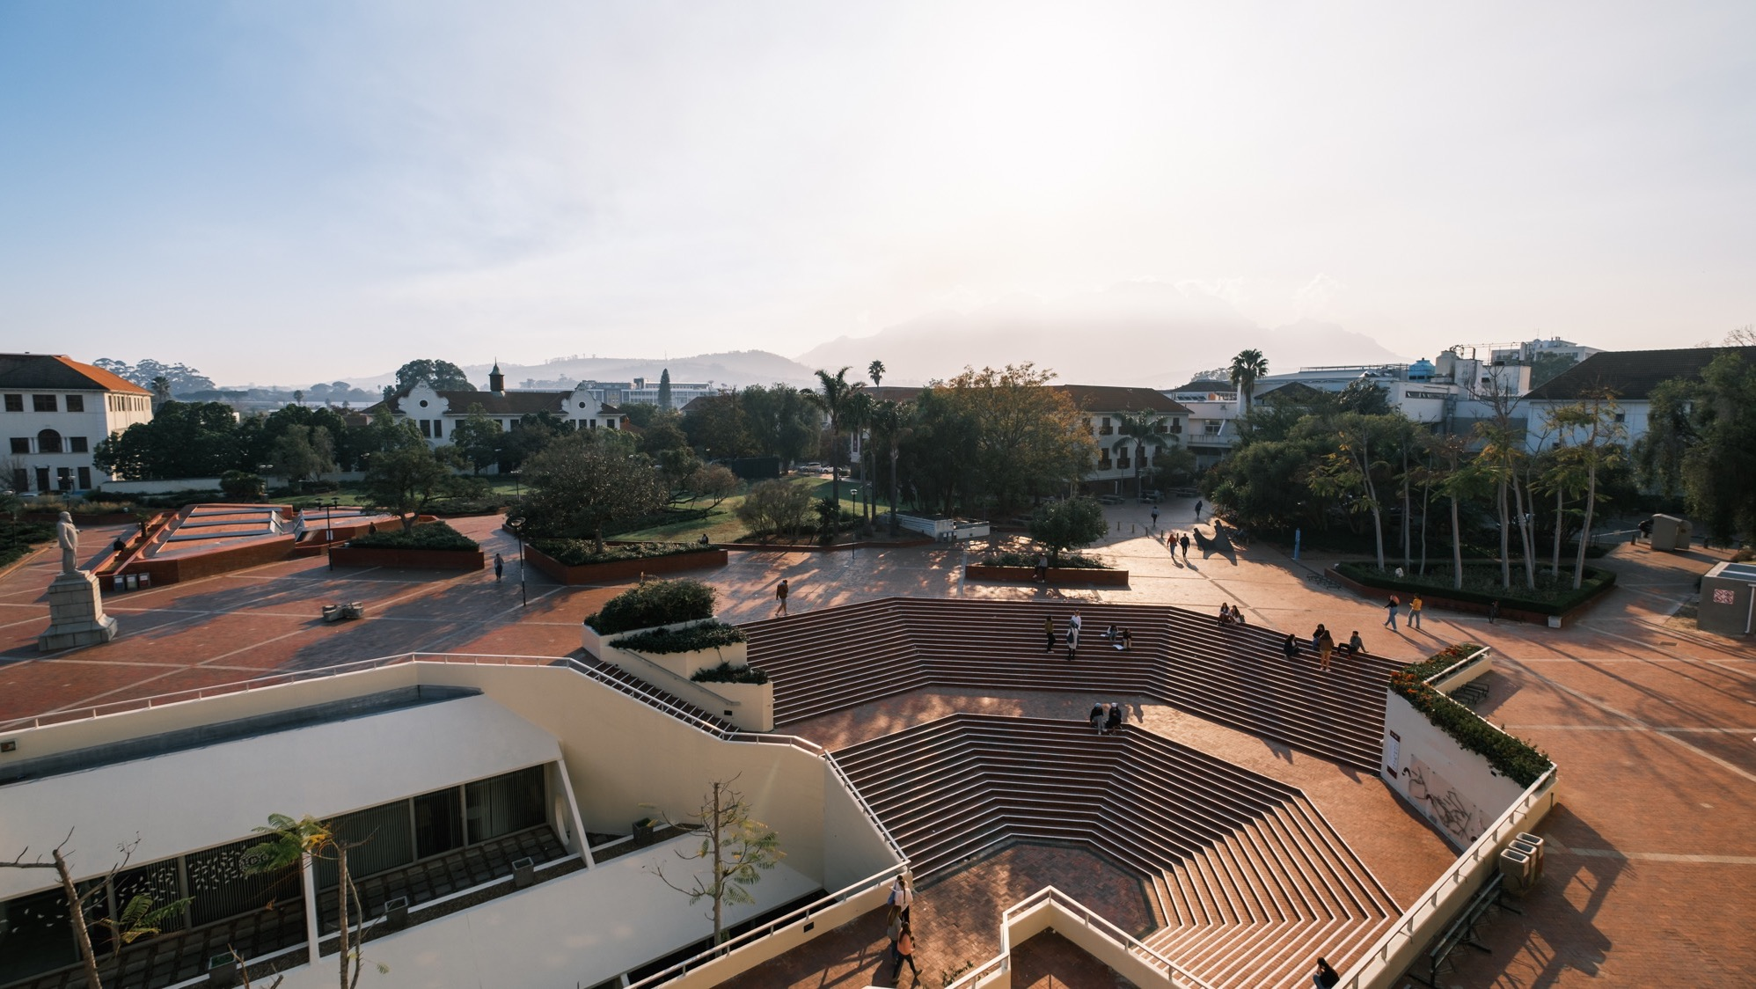
Thank you Enkosi Dankie
Photo by Stefan Els
Notes:
Cover/End slide layout
To change the picture:
Select the picture by clicking on it near the bottom of the slide (under the title placeholder), then click on the Picture Format tab.
Click on the Change Picture icon and choose the From a File/This Device… option.
Browse and select a picture and click on the Insert button.
Use the Crop command to adjust the image.
Click on the Crop command again to apply the changes.
Remember to add image attributions to photographs or artworks.

